Slide 1
Supply Chain Buddy App
Hack.2.Hire

Slide 2
TEAM MEMBERS
STEVENS PHILIP CSE 201700279
KRITIKA GARG CSE 201700513
AMBARISH DUTTA CSE 201700424
ANANYA SARKAR ECE 201700237

Slide 3
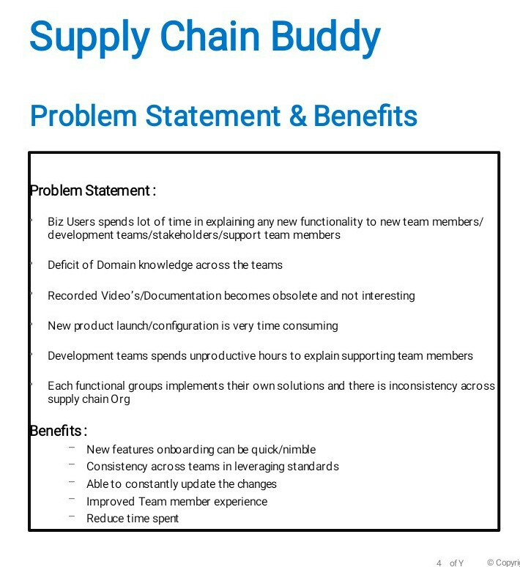

Slide 4
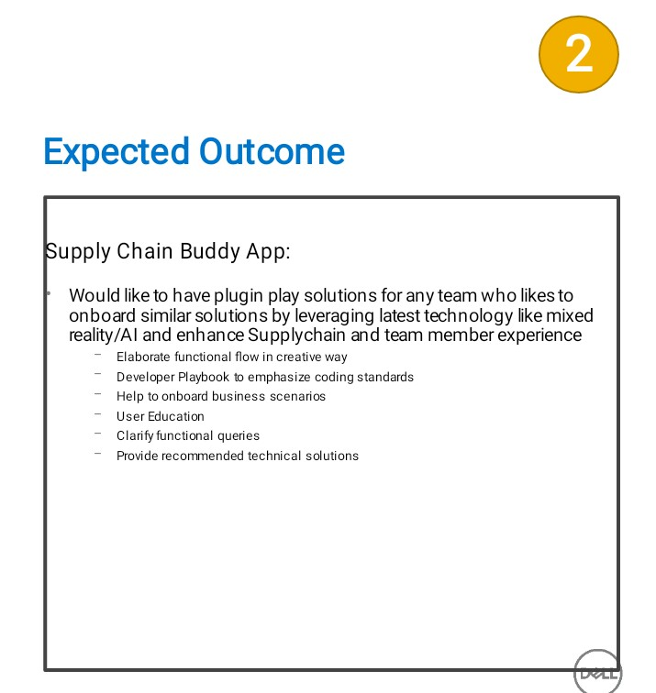

Slide 5
WEB APP
-This website is a one stop platform for Dell developers.
-Easily share domain knowledge among different team members
-Reduces the time spent in explaining new members
-Built with keeping user education in mind,
-Aims to provide accurate technical solutions.
-Helps to maintain Consistency and Uniformity across teams.

Slide 6
SOLUTION STRATEGY
SUPPLY CHAIN FUNCTIONAL FLOW
CODING STANDARDS
DISCUSSION FORUM
POST SECTION
USER MANUALS
RESPONSIVE UI

Slide 7
DEMONSTRATION

Slide 8
BENEFITS
TIME SAVING
EASY TO USE
REDUCES DEPENDENCY
MAINTAINS UNIFORMITY

Slide 9
FUTURE SCOPE
Can be hosted in cloud
Recommending of Right information at right time
Personalization based on user browsing .
Security

Slide 10

THANKS TO DELL TEAM

